Slide 1
Revature P2 Presentation
Eric Hom | Harish Kandaswamy | Miguel Pena
January 2025

Slide 2
Data Generator - Design
Harish
Final generated .csv requires 16 fields/columns
Split these into 4 classes which handle 4 columns each
order.py
transaction.py
customer.py
product.py
Each class handles related columns
Once classes are instantiated, those objects then contain the data for the fields
In main.py, new instances of the classes are instantiated and the data is consolidated into a single row
Theme of the products is pharmaceutical goods
Rogue data is generated randomly with a 3% chance
Inserts strings from a list of possible rogue data options into randomly selected columns
Notes:
Bullet format: Format > Bullets and numbering > First option
Name font color: dark orange 1

Slide 3
Order Class - order.py
Harish
This class handles the generation of data for 4 columns in the final row
order_id
qty
datetime
ecommerce_website_name
order_id is a static variable that increments for each new instantiation
Guarantees uniqueness
qty is a random number between 1 and 10
Generated randomly using Python’s random library
datetime is a random date and time in 2024
Generated randomly using Python’s radar library
Dates are categorized based on season
ecommerce_website_name is a random string indicating the website used for the purchase
Examples: CVS, Walgreens, Amazon, etc.
Notes:
Bullet format: Format > Bullets and numbering > First option
Name font color: dark orange 1

Slide 4
Order Class - Trends
Harish
order_id
No trends since it’s uniquely generated
qty
No trends since it’s random
datetime
Randomly generated date and time within the year 2024
Bias added for December dates and times due to holiday shopping
Categorized into seasons: spring, summer, fall, winter
ecommerce_website_name
Pulls from a list of 20 pharmaceutical goods websites
Since most customers are American, highest bias for Walgreens
High bias for CVS
Equal chance for other websites
Websites have domains in USA, UK, and AU

Slide 5
Transaction Class-
Transaction.py
Eric
The transaction subclass handles generation of these 4 columns:
payment_txn_id
payment_type
payment_txn_success
failure_reason
payment_txn_id is a randomly generated 8 digit integer
Generated using random.randint()
Generated IDs are appended to a list and checked for duplicates, to ensure uniqueness
payment_type consists of four possible values- wallet, card, upi, or internet banking
chosen using random.random() with weights
payment_txn_success- either 0 or 1
chosen using random.random() with weights
failure_reason is dependent on payment_type and payment_txn_success, with six possible values-
‘insufficient credit’, ‘insufficient funds’, ‘card expired’, ‘payment method not accepted at merchant’, ‘billing address incorrect’, ‘bank refused to authorize transaction’
Chosen using random.randint()

Slide 6
Transaction Class-
Trends
Eric
Payment_txn_id
No trend, randomly generated and unique
payment_type
Randomly generated, with results weighted toward 50% wallet, 34% card (credit + debit), 7% upi, and 9% internet banking
Modeled after real-world data from https://www.statista.com/statistics/1111233/payment-method-usage-transaction-volume-share-worldwide/
Payment_txn_success
Randomly generated, with results weighted toward a 90% success rate and 10% failure rate
Failure_reason
If payment_type is not card, failure reasons are distributed roughly equally between ‘insufficient funds’, ‘payment method not accepted at merchant’, ‘billing address incorrect’, ‘bank refused to authorize transaction’
If payment type is card, failure reasons are also roughly distributed equally between the above reasons, as well as ‘insufficient credit’, and ‘card expired’

Slide 7
Product and Customer Classes
Miguel
These two subclasses handle generation of the following columns:
product_id and customer_id
product_name and customer_name
price
country
city
product_category
Initially stored as two separate JSON files with entries containing their respective data.
Products or Customers are selected randomly with a normalized chance using numpy.
Additional Trends are created by adding or removing entries from different categories or countries.
Depending on the season, certain products from a set number of categories are chosen more often.
Notes:
I’ll show the JSON files, since it won’t fit here.

Slide 8

Data Generator - Demo
Miguel

Slide 9
Data Cleaner Class
Miguel
Before analysis could begin, we passed the DataFrame through a cleaner object that performed a series of transformations that “cleaned” the data and made it easier to analyze.
Remove failed transactions
Filters on payment_txn_success==True
Drop id columns
Drop all id columns, since they don’t provide useful analysis information.
Remove corrupted rows
calls replace on known rogue data like ‘null’ and ‘Unknown’ and replace with None
Drop rows with dropna, which drops rows that contain None
Split datetime
Splits datetime into year, month, quarter, hour, and fiscal period with the .withColumn transformation.
Remove pre-2021 data
Dataset contained scattered points for every year before 2021 down to 1960, so we dropped these.
Replace country names
Replace two letter abbreviations with full names.

Slide 10
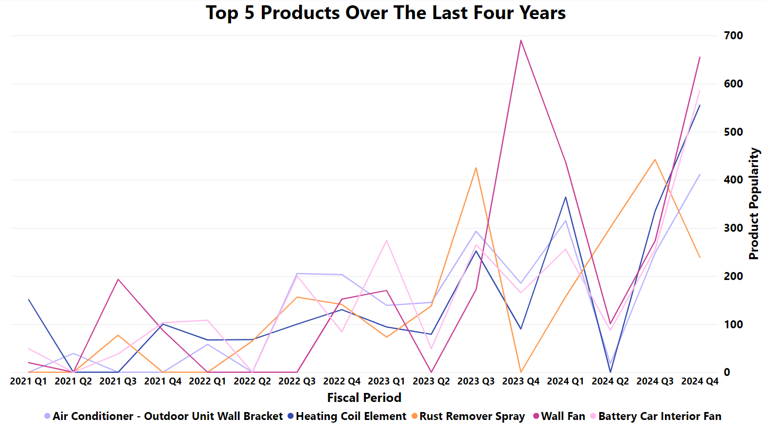
Data Analysis - Product Popularity
Miguel
Notes:
Theme is Sunset, Title font size is 24, axis title font size is 14, axis value font size is 12, legend text font size is 14, all are set to bold.

Slide 11
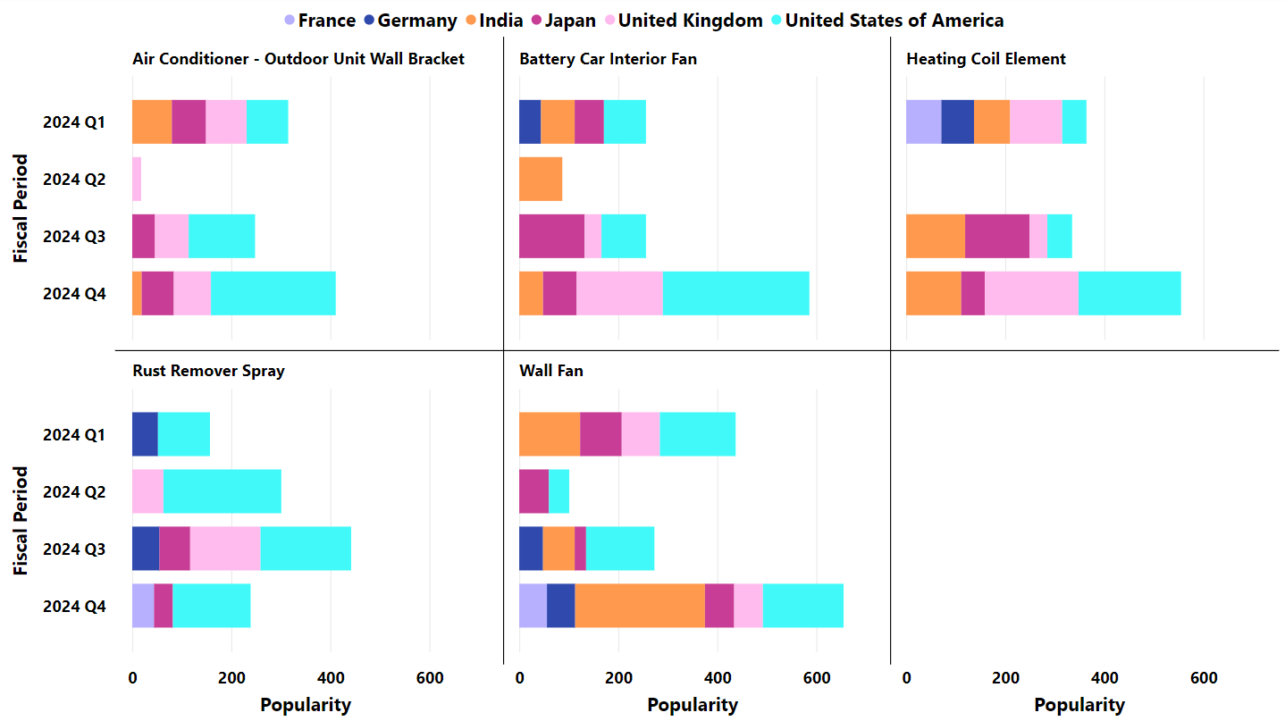
Data Analysis - Product Popularity by Country
Miguel
Notes:
Theme is Sunset, Title font size is 24, axis title font size is 14, axis value font size is 12, legend text font size is 14, all are set to bold.

Slide 12
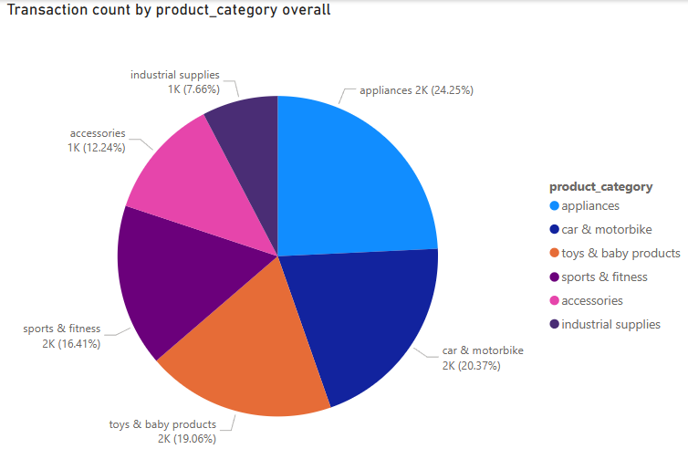
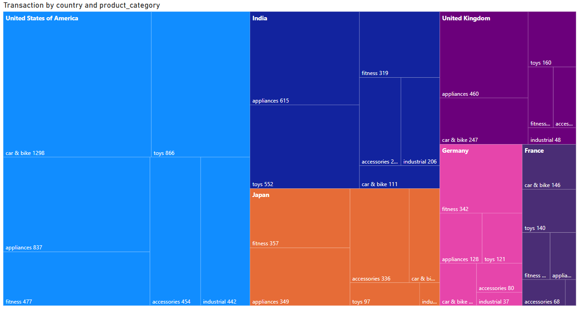
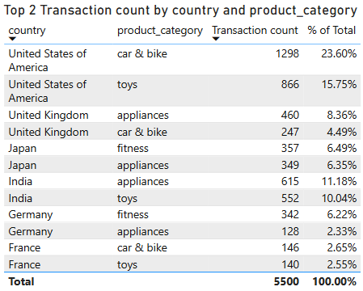
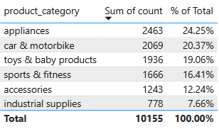
Data Analysis- Top Selling Categories
Eric

Slide 13
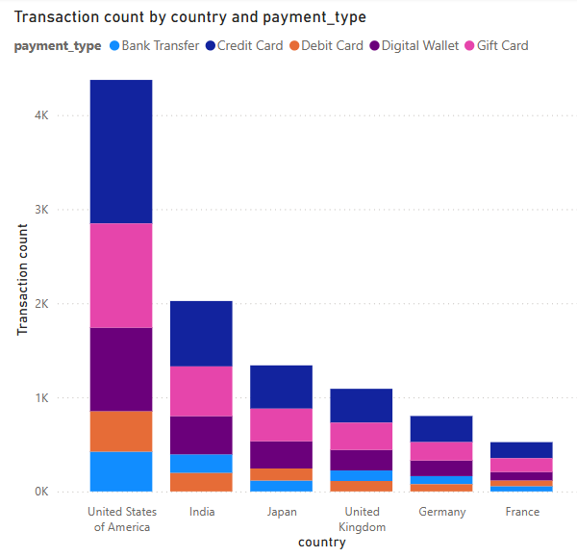
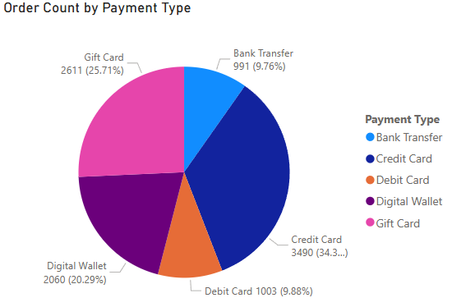
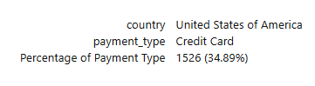
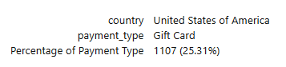
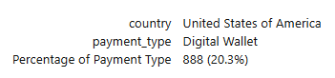
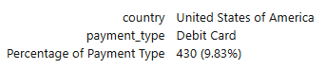
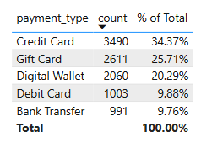
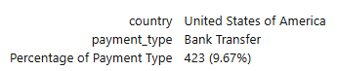
Data Analysis- Transactions
Eric

Slide 14
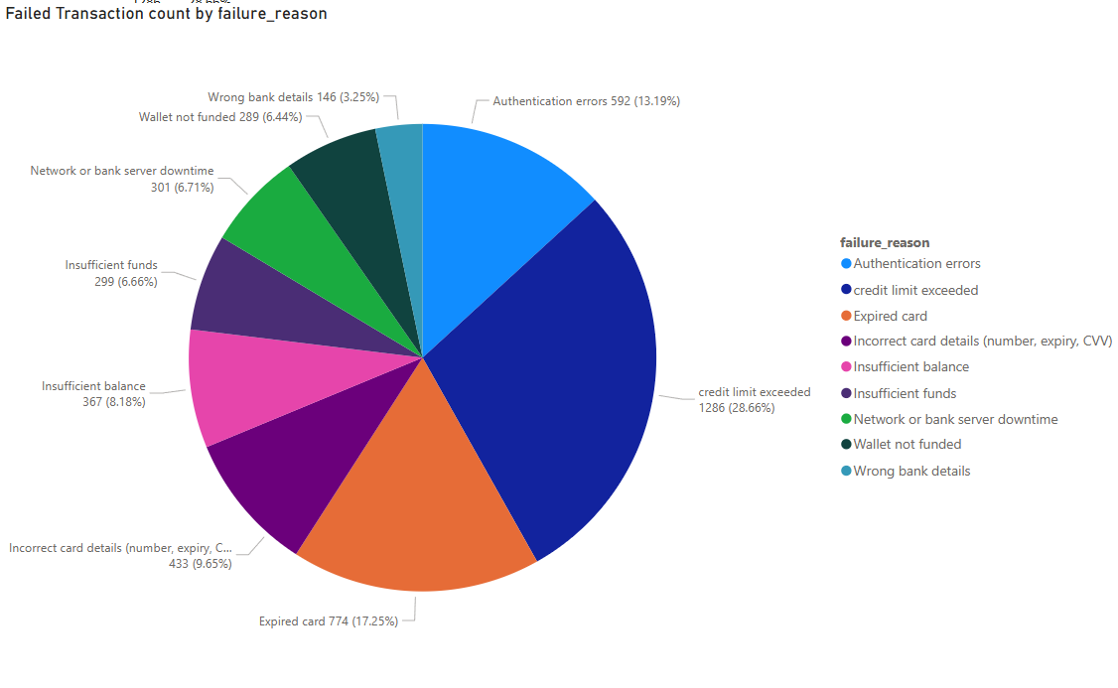
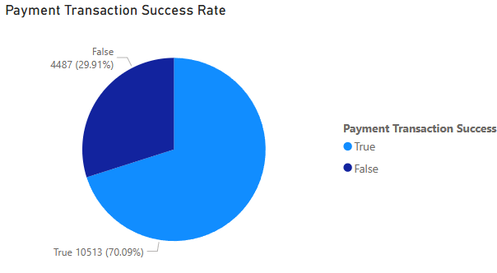
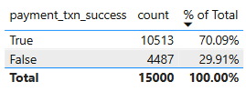
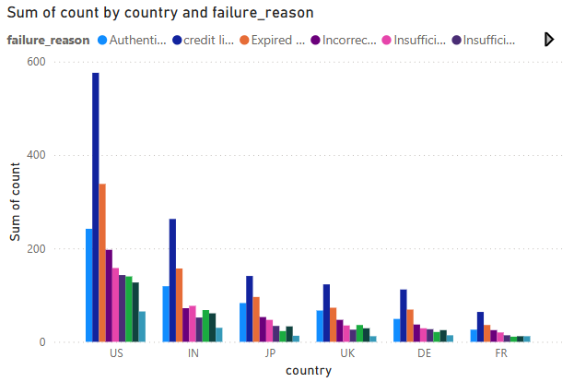
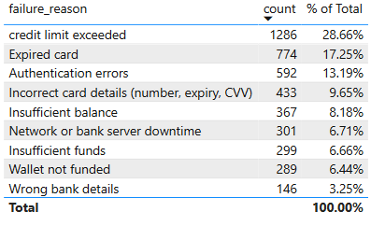
Data Analysis- Transactions
Eric

Slide 15
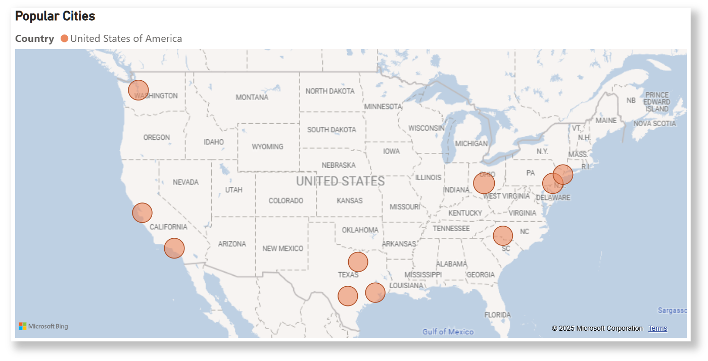
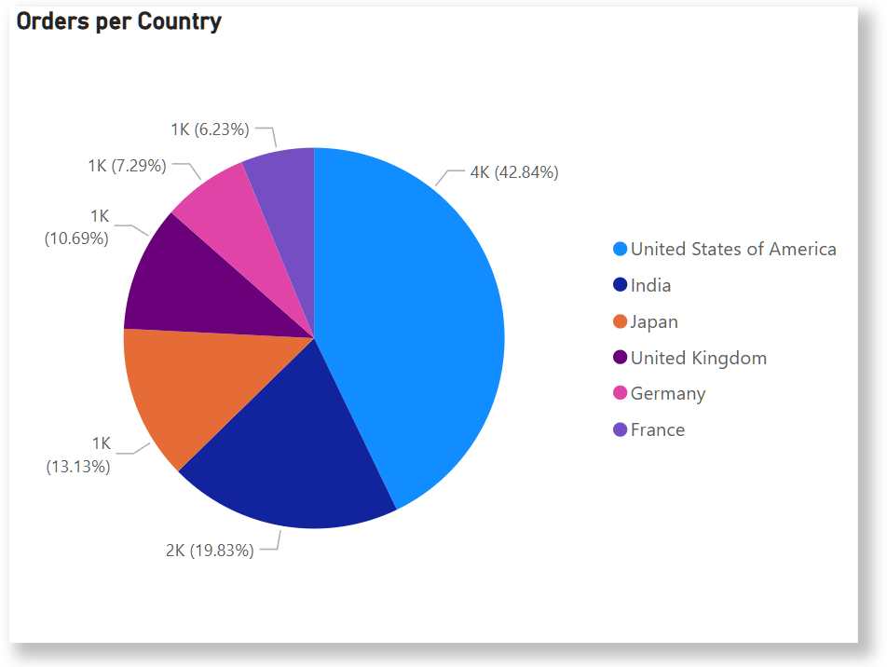
Data Analysis- Popular Locations
Harish

Slide 16
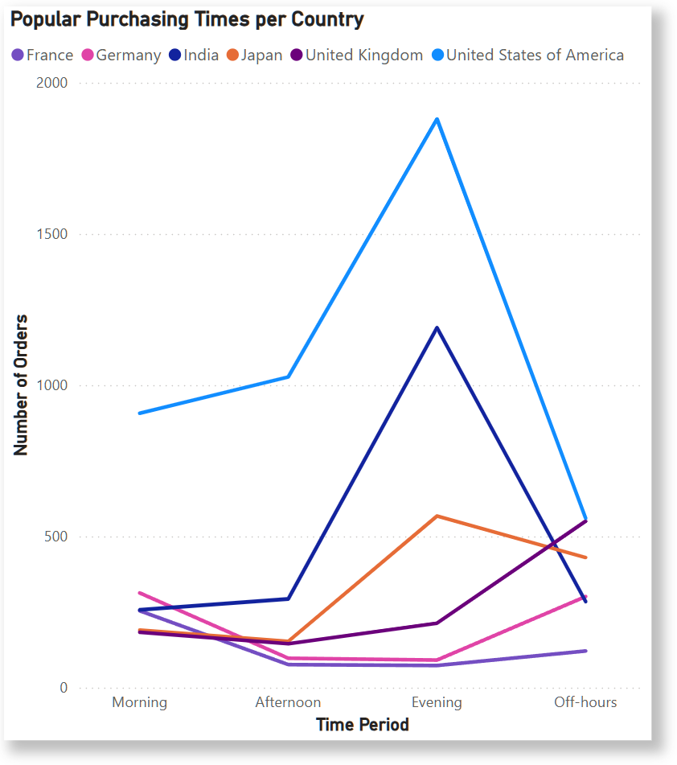
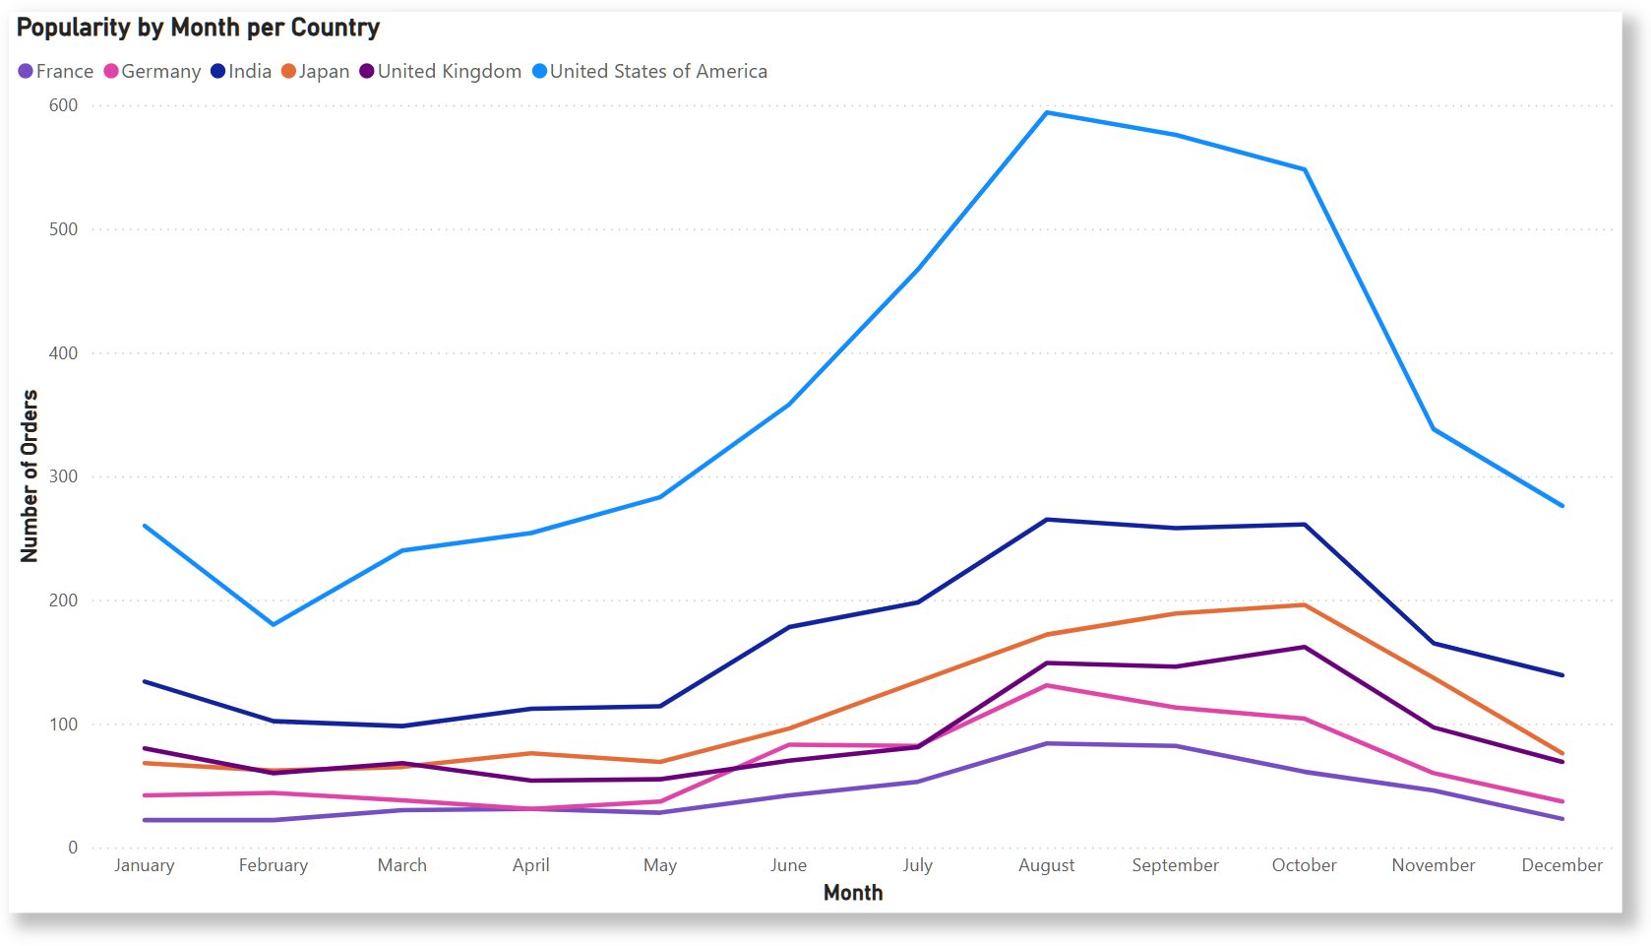
Data Analysis- Popular Times
Harish

